Slide 1
ECE 884 Deep Learning
Lecture 2: Machine Learning Basics - 1
01/21/2021

Slide 2
Logistics
Slack workspace
Google sheet

Slide 3
Today’s lecture
What is Machine Learning?
Supervised Learning Pipeline
Features
Hypothesis Space
Characteristics of Data Sets

Slide 4
What is machine learning?

Slide 5
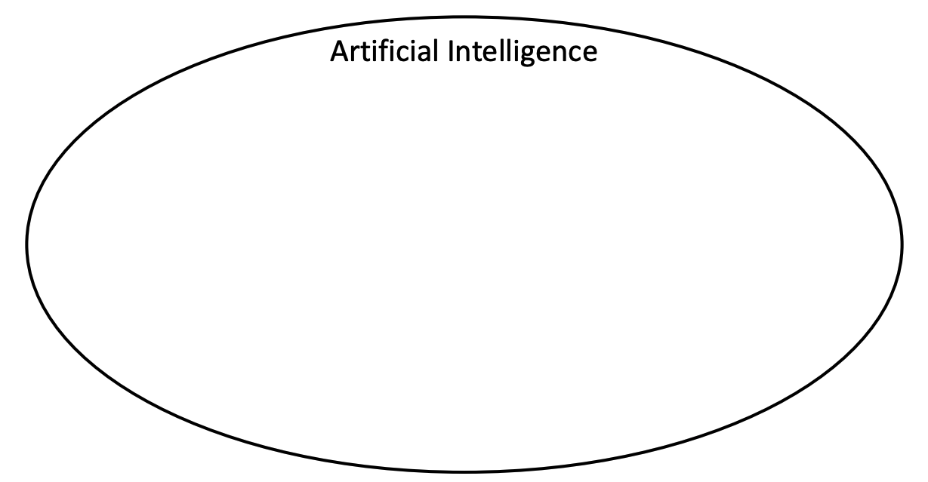

Slide 6
Machine Learning

Slide 7
Machine Learning
Deep Learning

Slide 8
What is Machine Learning?
It is very hard to write programs that solve problems like recognizing a three-dimensional object from a novel viewpoint in new lighting conditions in a cluttered scene.
We don’t know what program to write because we don’t know how its done in our brain.
Even if we had a good idea about how to do it, the program might be horrendously complicated.
It is hard to write a program to compute the probability that a credit card transaction is fraudulent.
There may not be any rules that are both simple and reliable. We need to combine a very large number of weak rules.
Fraud is a moving target. The program needs to keep changing.

Slide 9
The Machine Learning Approach
Instead of writing a program by hand for each specific task, we collect lots of examples that specify the correct output for a given input.
A machine learning algorithm then takes these examples and produces a program that does the job.
The program produced by the learning algorithm may look very different from a typical hand-written program. It may contain millions of numbers.
If we do it right, the program works for new cases as well as the ones we trained it on.
If the data changes the program can change too by training on the new data.
Massive amounts of computation are now cheaper than paying someone to write a task-specific program.

Slide 10
Some examples of tasks best solved by learning
Recognizing patterns:
Objects in real scenes
Facial identities or facial expressions
Spoken words
Recognizing anomalies:
Unusual sequences of credit card transactions
Unusual patterns of sensor readings in a nuclear power plant
Prediction:
Future stock prices or currency exchange rates
Which movies will a person like?

Slide 11
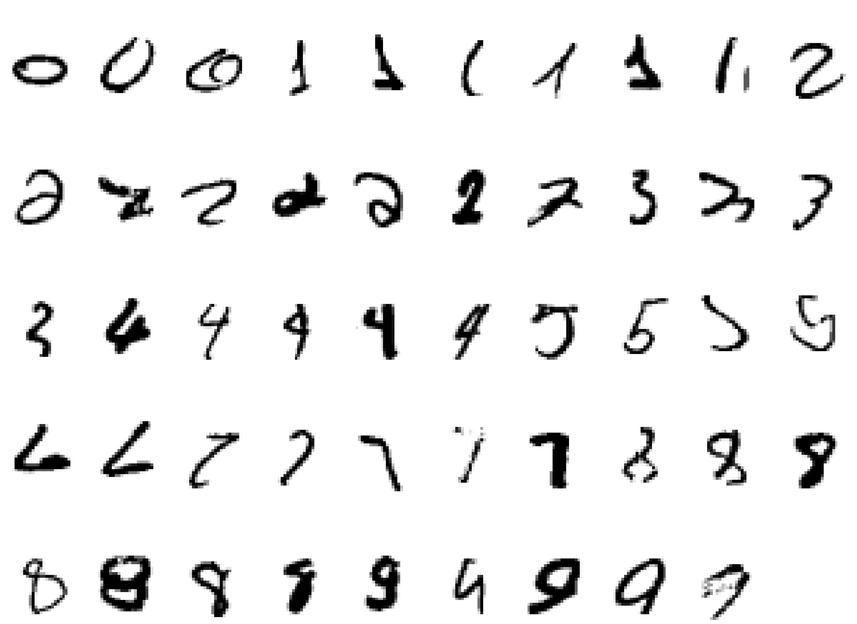
A standard example of machine learning
The MNIST database of hand-written digits.

Slide 12
It is very hard to say what makes a 2

Slide 13
There are many different flavors of machine learning

Slide 14
Supervised Learning
Given inputs (data-label pairs), learn a model to predict output

Slide 15

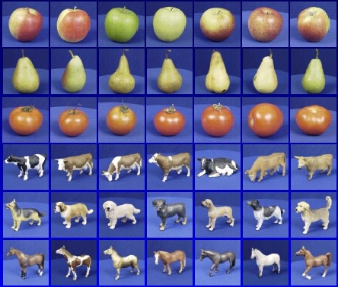
Example: Image Classification
input
desired output
apple
apple
pear
pear
tomato
tomato
cow
cow
dog
dog
horse
horse
Example: Lazebnik, Images: ETH-80 dataset

Slide 16
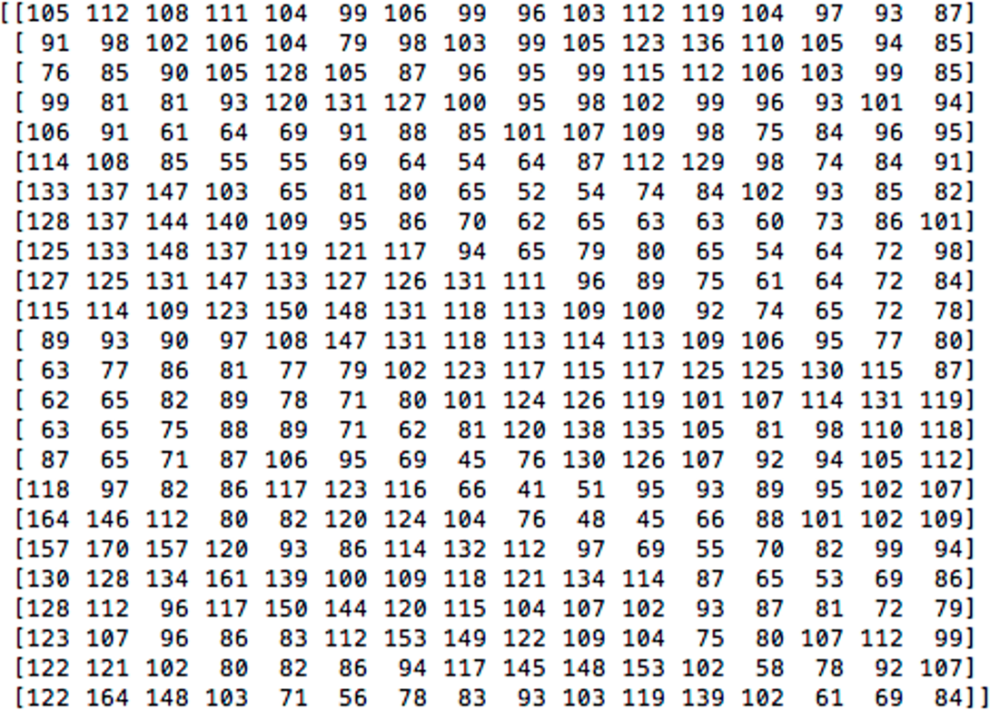
Example: Image Classification
apple
pear
tomato
cow
What the computer sees
An image is just a big grid of numbers between [0, 255]:
dog
horse
Example: Lazebnik, Images: ETH-80 dataset

Slide 17

Supervised Learning Pipeline
Training Samples
apple
Features
Training time
pear
Learned model
Training
tomato
cow
Training Labels
dog
horse
Testing time
Learned Model
Features
Prediction
Test Sample
Credit: Lazebnik

Slide 18
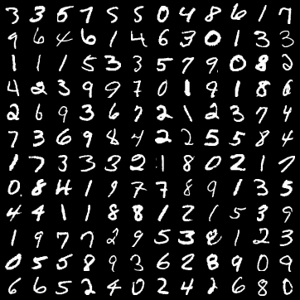
Image Classification Datasets: MNIST
10 classes: Digits 0 to 9 28x28 grayscale images 50k training images 10k test images

Slide 19
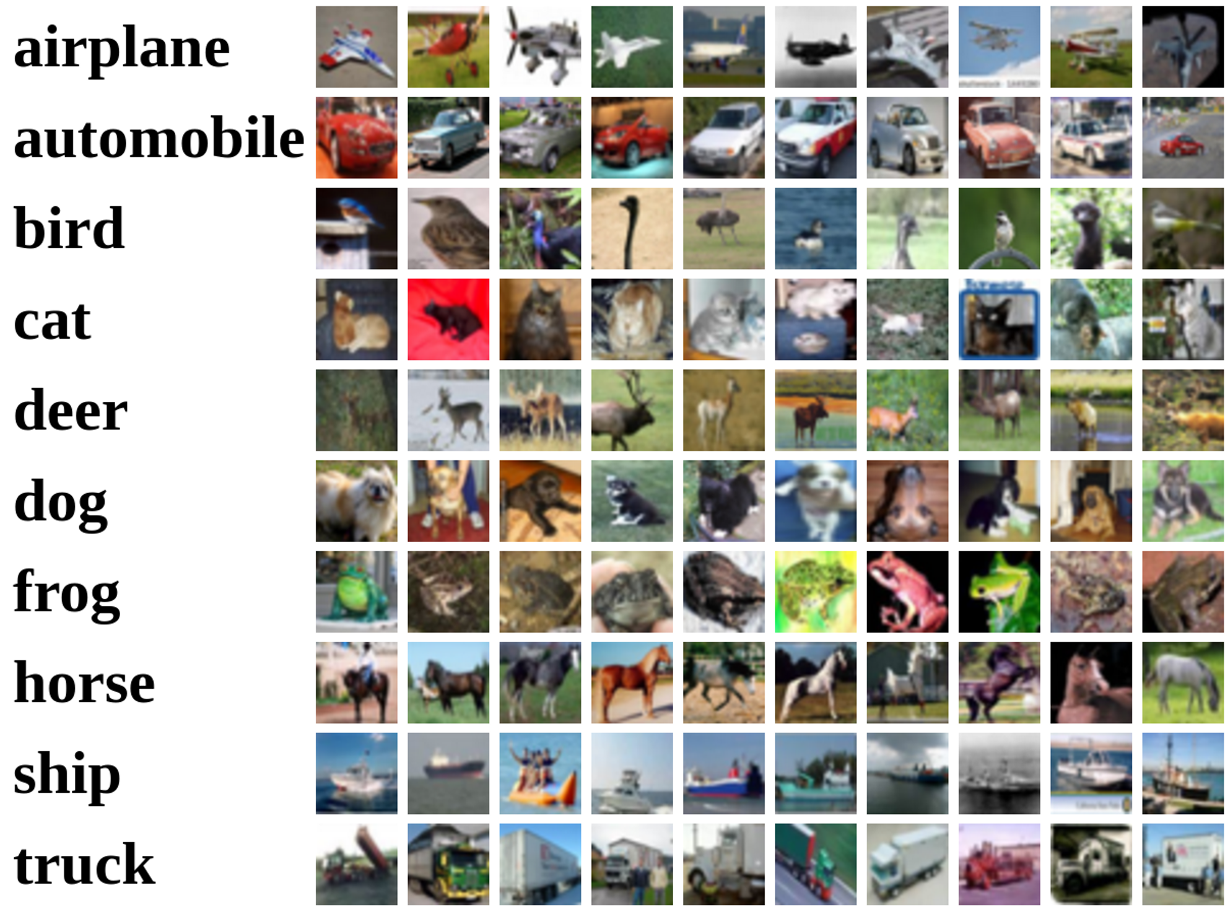
Image Classification Datasets: CIFAR10
10 classes
50k training images (5k per class) 10k testing images (1k per class) 32x32 RGB images

Slide 20
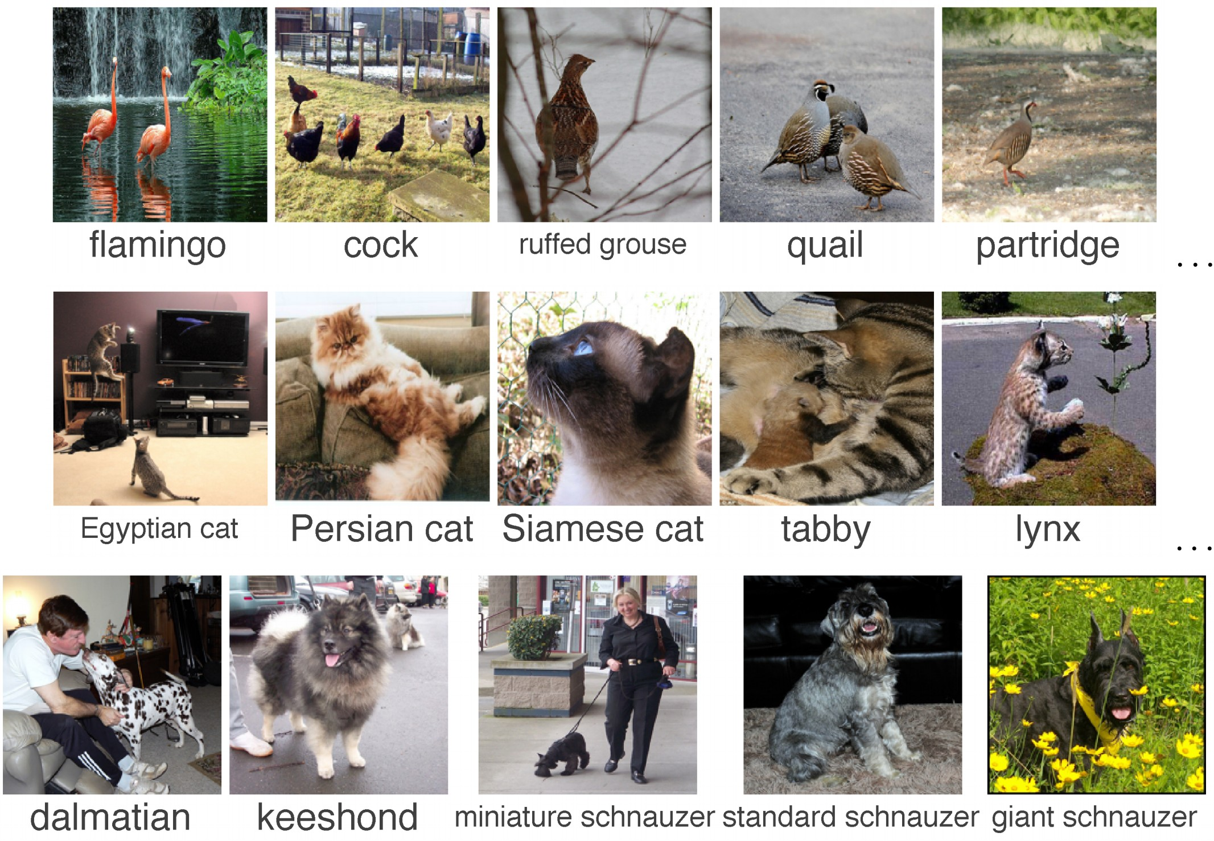
Image Classification Datasets: ImageNet
1000 classes
~1.3M training images (~1.3K per class) 50K validation images (50 per class) 100K test images (100 per class)

Slide 21
Supervised Learning Formulation
y = f(x)
output
prediction function
input
Training (or learning): given a training set of labeled examples {(x₁,y₁), …, (x_{N},y_{N})}, instantiate a predictor f
Testing (or inference): apply f to a new test example x and output the predicted value y = f(x)
Credit: Lazebnik

Slide 22
Supervised Learning Formulation
y = f(x)
output
prediction function
input
Formulation:
Given training data: {(x₁,y₁), …, (x_{N},y_{N})},
Find y = f(x) using training data
• such that f is correct on test data
Credit: Lazebnik, Liang

Slide 23
Supervised Learning Formulation
y = f(x)
output
prediction function
input
Formulation:
Given training data: {(x₁,y₁), …, (x_{N},y_{N})},
Find y = f(x) using training data
What kind of functions are allowed?
• such that f is correct on test data
Credit: Lazebnik, Liang

Slide 24
Supervised Learning Formulation
y = f(x)
output
prediction function
input
Formulation:
Given training data: {(x₁,y₁), …, (x_{N},y_{N})},
Find y = f(x) ∈ " using training data
Hypothesis space of f
• such that f is correct on test data
Credit: Lazebnik, Liang

Slide 25
Supervised Learning Formulation
y = f(x)
output
prediction function
input
Formulation:
Given training data: {(x₁,y₁), …, (x_{N},y_{N})},
Find y = f(x) ∈ " using training data
Is there any connection between training and test data?
• such that f is correct on test data
Credit: Lazebnik, Liang

Slide 26
Supervised Learning Formulation
y = f(x)
output
prediction function
input
Formulation:
Given training data: {(x₁,y₁), …, (x_{N},y_{N})},
Find y = f(x) ∈ " using training data
i.i.d. samples from the same distribution D
• such that f is correct on test data
Credit: Lazebnik, Liang

Slide 27
Any Question ?

